Slide 1

GEOL593: Seismology and Earth Structure, Spring 2023
Lecture 14: Frontiers of seismology

Slide 2
Class schedule
 | Dates | Topic | Lab assignment
Week 1: | Jan 17, Jan 19 | Course overview | Lab 1: Python crash course
Week 2: | Jan 24, Jan 26 | Seismic signal processing | Lab 2: Introduction to Obspy
Week 3: | Jan 31, Feb 2 | Moment Tensors/ Inverse methods | Lab 3: Moment tensor inversion
Week 4: | Feb 7, Feb 9 | 🤮 No class, Ross ill | Seismic wave propagation 1
Week 5: | Feb 14, Feb 16 | Lab 4: Reference Earth models: The “1D” Earth | Seismic wave propagation 2
Week 6: | Feb 21, Feb 23 | Lab 5: Surface wave dispersion | Surface waves and normal modes
Week 7: | Feb 28, Mar 2 | Lab 6: Normal modes | Imaging Earth Structure 1: Seismic tomography
Week 8: | Mar 7, Mar 9 | Lab 7: Seismic Tomography | Imaging Earth Structure 2: Seismic discontinuities / Research paper discussion
Week 9: |  | Spring break
Week 10: | Mar 21, Mar 23 | Lab 8. Receiver Functions | Anisotropy and anelasticity
Week 11: | Mar 28, Mar 30 | Planetary seismology 1 | Lab 9: InSight- Seismology on Mars
Week 12: | Apr 4, Apr 6 | Planetary seismology 2
Week 13: | Apr 11, Apr 13 | Machine learning in seismology 1 | Lab 10: Earthquake detection
Week 14: | Apr 18, Apr 20 | Machine learning in seismology 2
Week 15: | Apr 25, Apr 27 | Frontiers of seismology: What’s next? | Research Paper Presentations (?)
Week 16: | May 2, May 4 | Research paper presentations | Reading Day

Slide 3
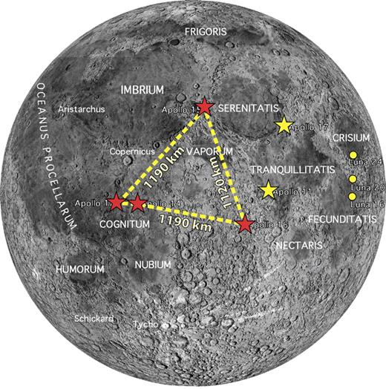
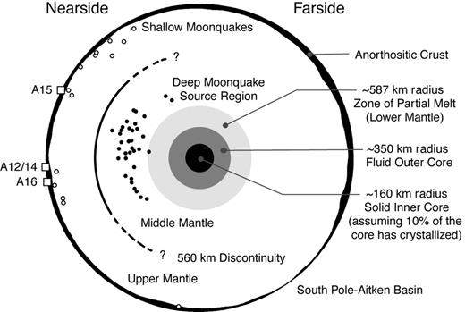
Lunar exploration
With the upcoming Artemis mission to return humans to the Moon, there has been a renewed effort to advance lunar science, including using seismology to understand the internal structure and nature of seismic activity.
Some important outstanding questions :
Nature of moonquakes. Why do deep moonquakes happen (should be in ductile mantle). Are shallow moonquakes related to lobate scarps? Is the far side seismically active?
Crustal structure and lateral variation
Core structure. Partial melt layer near core-mantle boundary? Insights into extinct lunar dynamo?

Slide 4
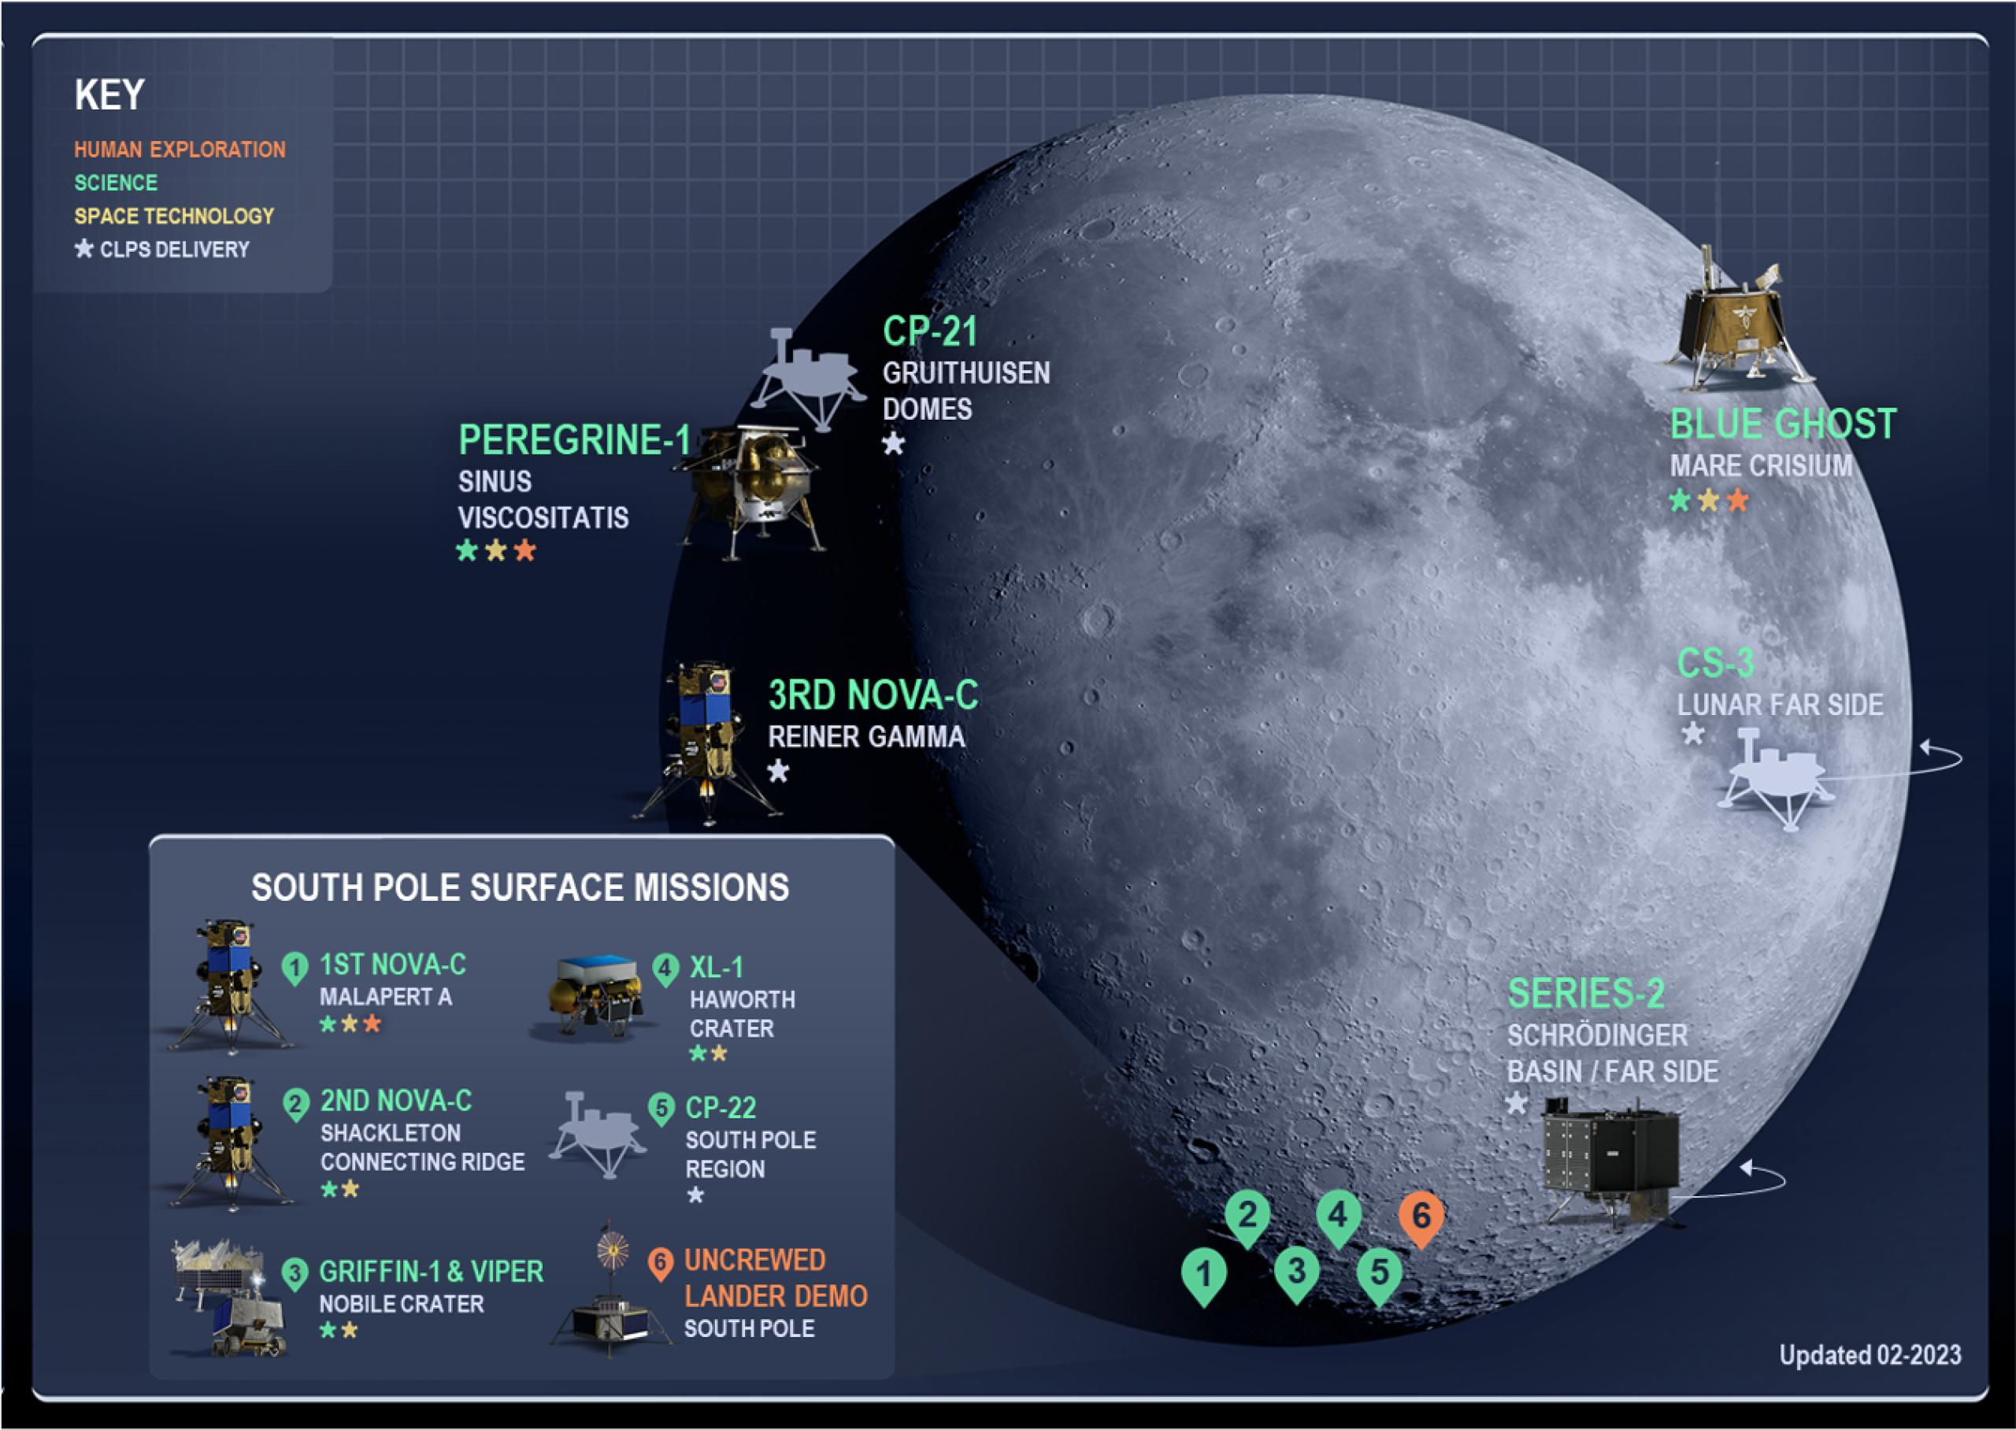
Commercial Lunar Payload Services (CLPS)
NASA program to contract transportation of small payloads to lunar surface.
Primary purpose is scouting lunar in-situ lunar resources and performing science to support Artemis.
Multiple CLPS landers will carry geophysical instruments, including the Far Side Seismic Suite mission, which will land in Schrodinger Basin near the lunar south pole.
CLPS providers include Lockheed Martin, Blue Origin, SpaceX, Firefly Aerospace and others
Carry 30 – 50 kg of payload
Only last 1 lunar day.

Slide 5
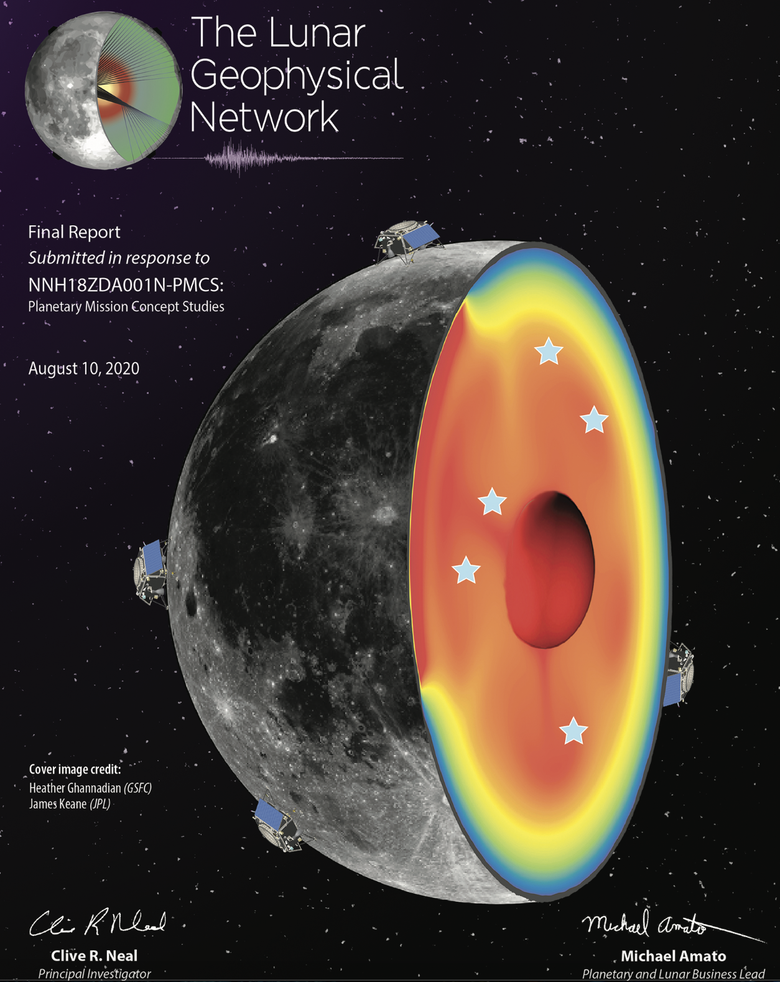
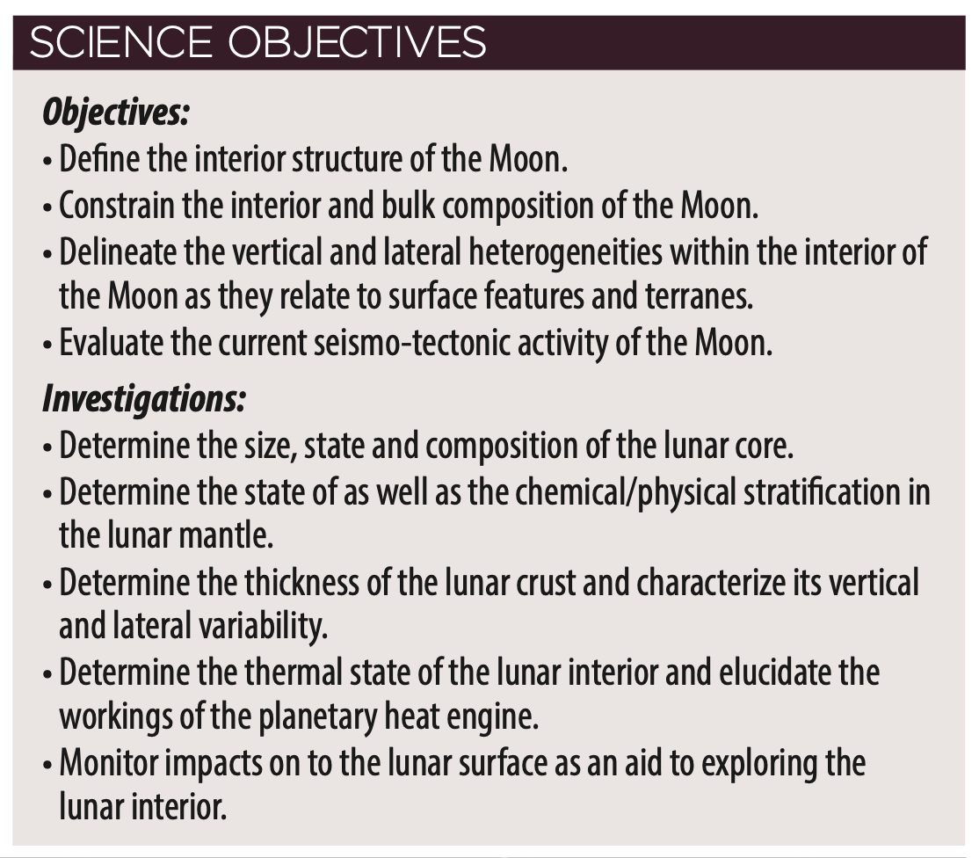
Lunar Geophysical Network
LGN is currently being developed as a New Horizons mission proposal, with the main goal is to understand the early stages of terrestrial planet formation

Slide 6
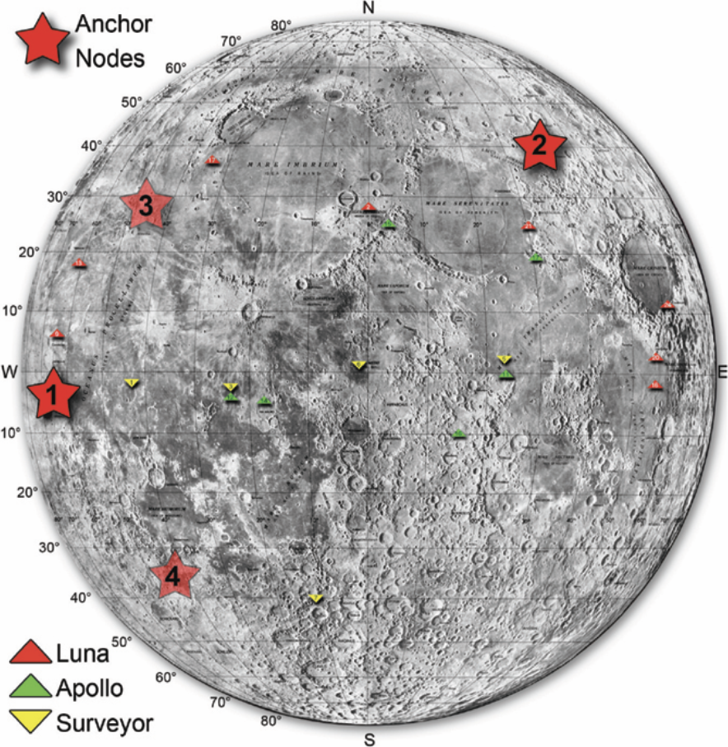
Lunar Geophysical Network
Why do we need LGN?
CLPS missions are too brief and don’t all carry geophysical instrumentation.
Human-aided seismic experiments may be an important component of Artemis, but to answer important questions about the moon requires a global network, not a single landing site. Seismometers deployed at the Artemis landing site would be a welcome addition to a broader LGN.

Slide 7
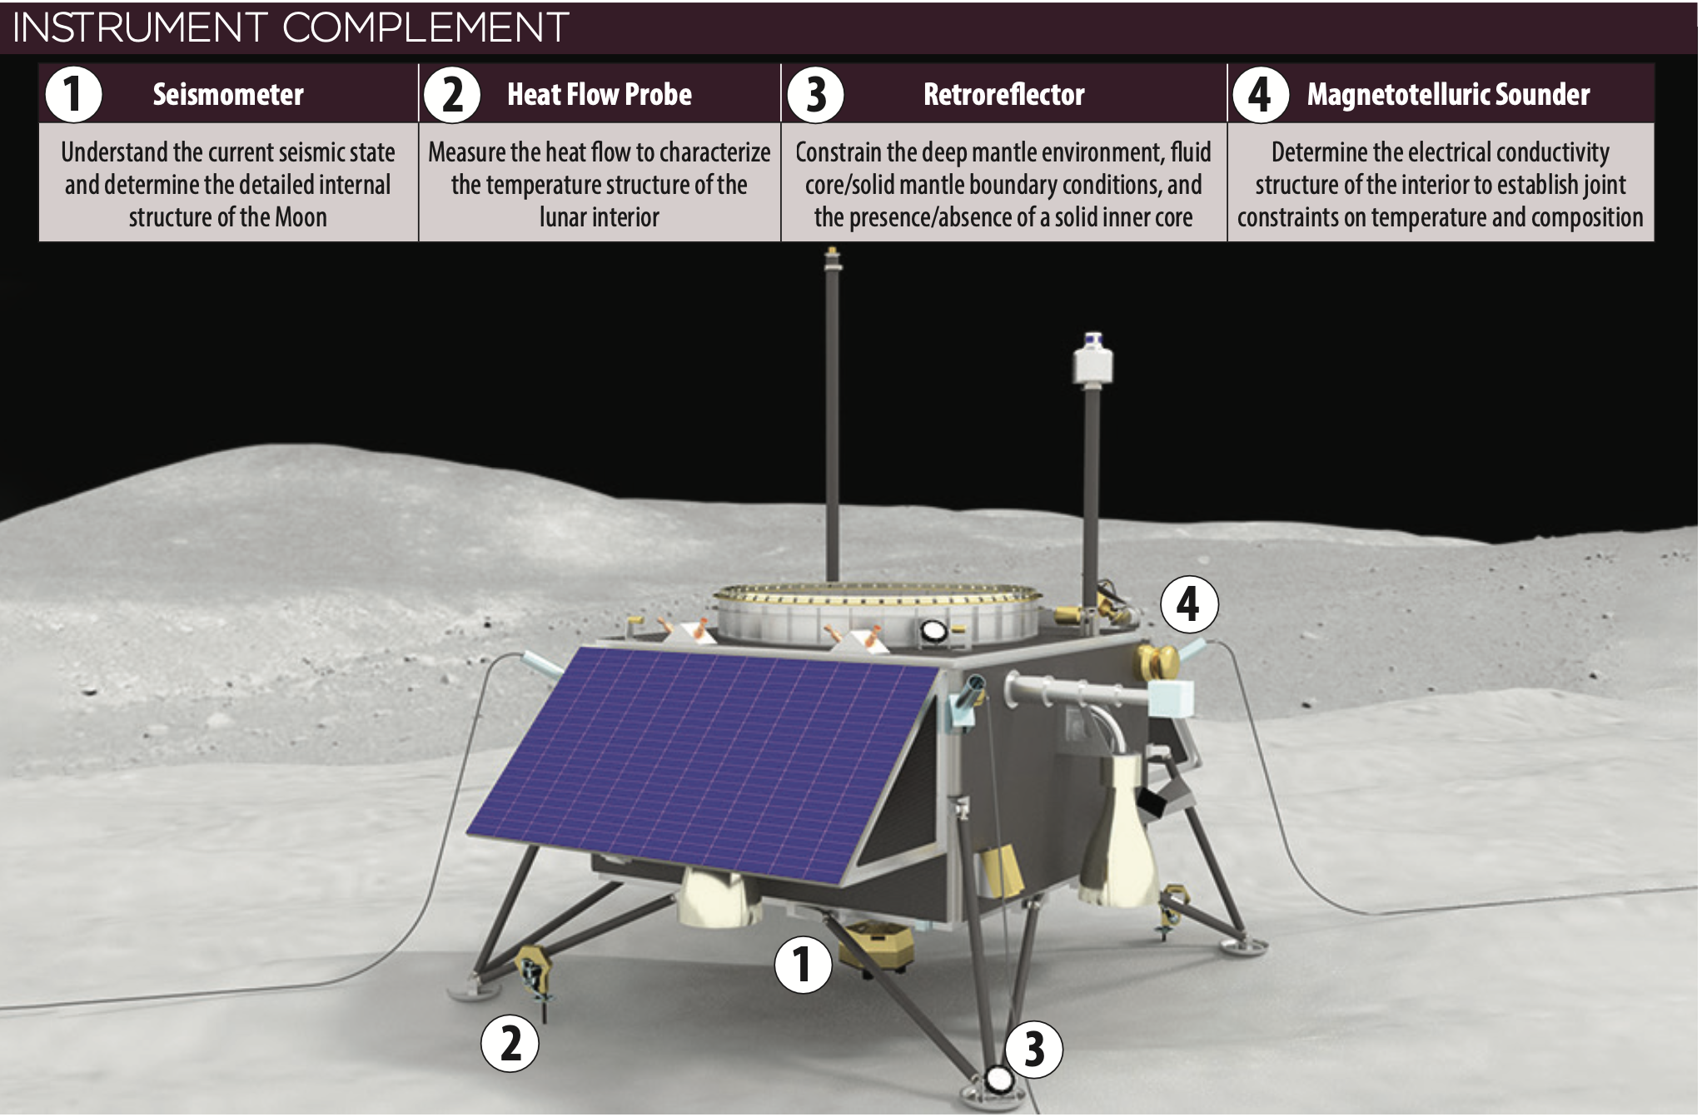
LGN Lander Concept

Slide 8
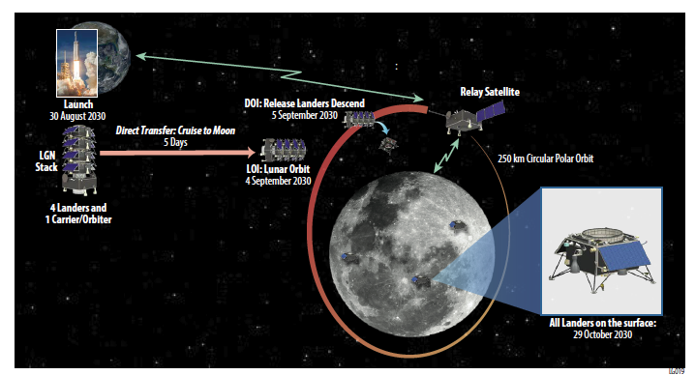
Mission Design
Potential launch in 2030. Suggested mission duration of at least 10 years.

Slide 9
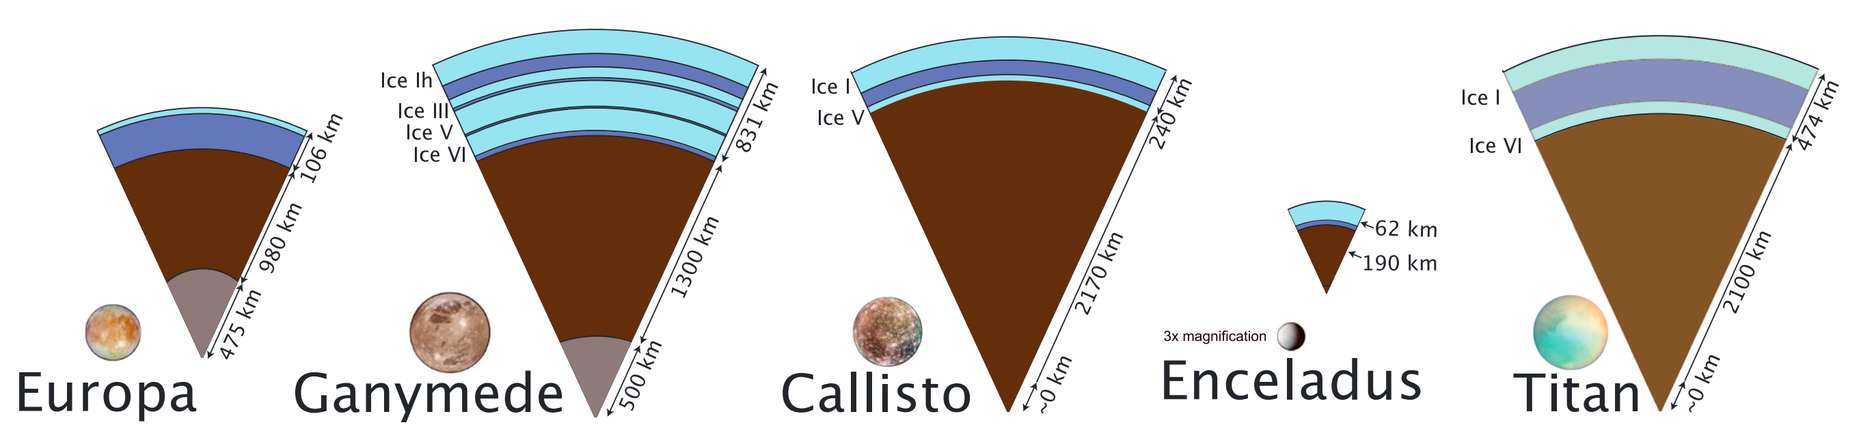
Seismology on Icy Ocean Worlds
Vance et al., 2018

Slide 10
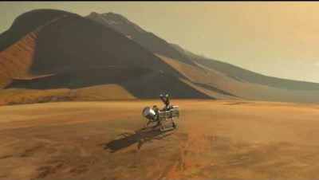
NASA Dragonfly mission
NASA’s dragonfly mission is anticipated to launch in 2027 and arrive at Saturn’s moon Titan in 2034, where it will begin searching for signs of life. It will also carry geophysical equipment, including a seismometer.

Slide 11
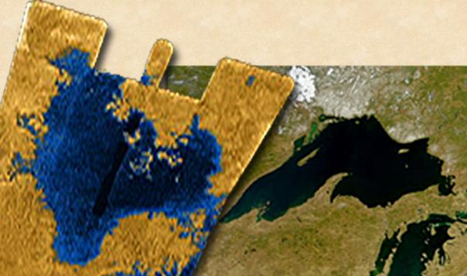
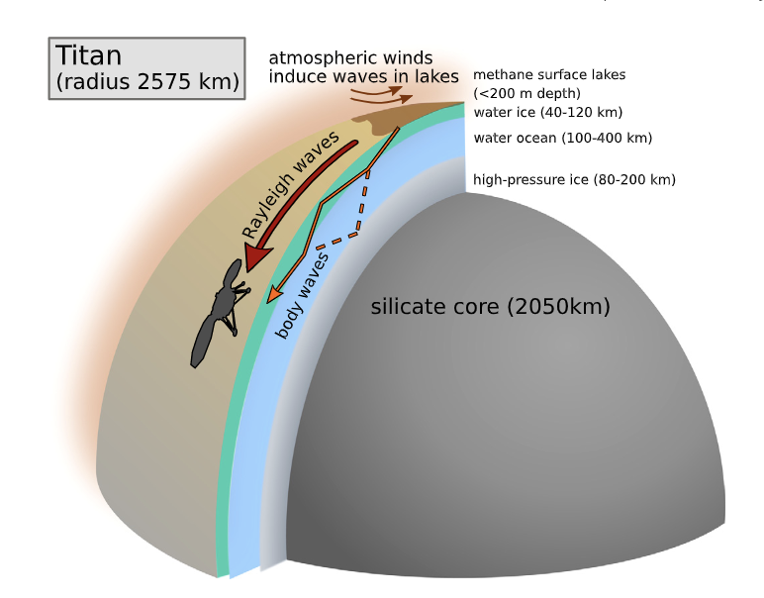
Seismic signals from the lakes of Titan
Titan is the only body in the solar system besides Earth that has permanent liquid seas at the surface. Instead of liquid water, like on Earth, Titan’s seas are liquid methane.
As on Earth, wind perturbing the seas is expected to create seismic noise that can be recorded by seismometers, and enable imaging of the interior.
Storm-induced microseisms are likely to be globally detectable on Titan with sensitive seismometers, if wind speeds exceed 2 m/s.
Seismicity could also be observed from fracturing in the outer ice shell, or quakes in the silicate interior.
Stahler et al., 2019

Slide 12
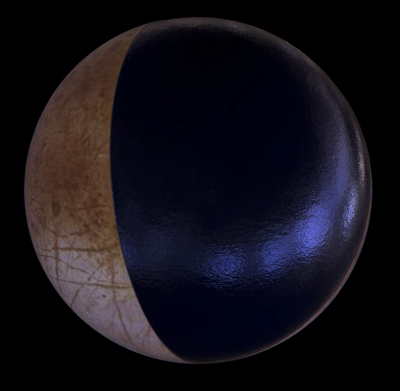
Probing Europa’s subsurface ocean
Surface imagery and geophysical evidence (e.g., magnetometer data; Kivelson et al., 2000) strongly suggest a global subsurface ocean
Subsurface ocean is an intriguing target for searching for life outside of Earth
Future efforts aimed at exploring the subsurface ocean require knowledge of the ice shell structure
https://europa.nasa.gov/

Slide 13
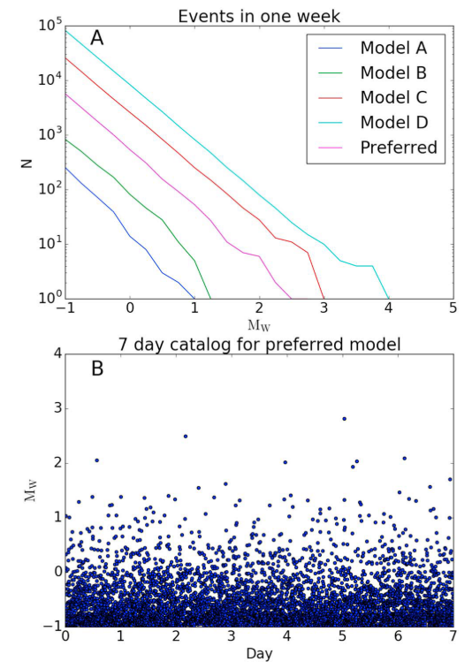
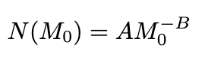
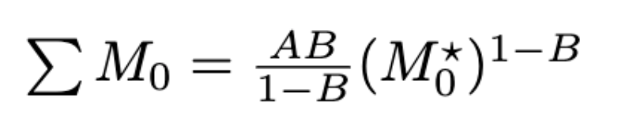
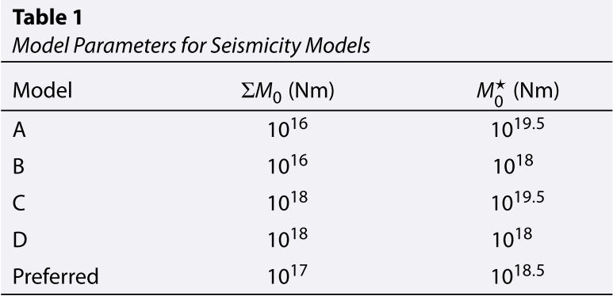
How seismically active is Europa?
~1 Mw 3 event per week
Panning et al. (2018)
(e.g., Golombek et al. 1992)
Cumulative seismic moment
Maximum event size

Slide 14
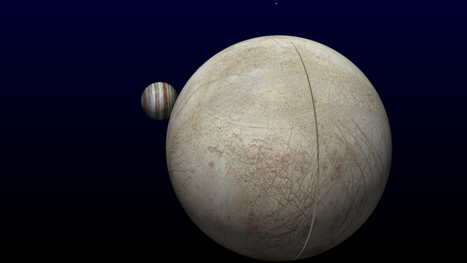
Simon Stähler

Slide 15
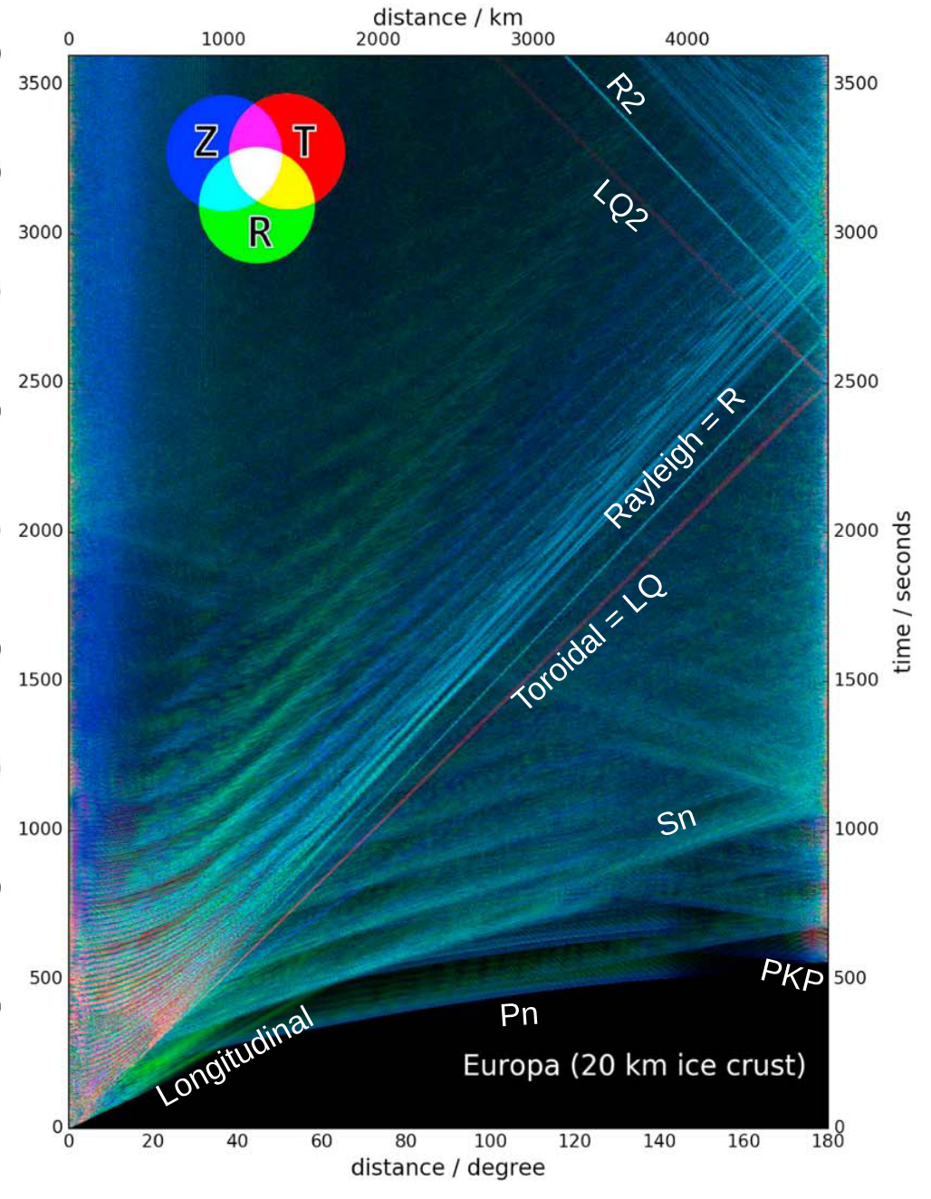
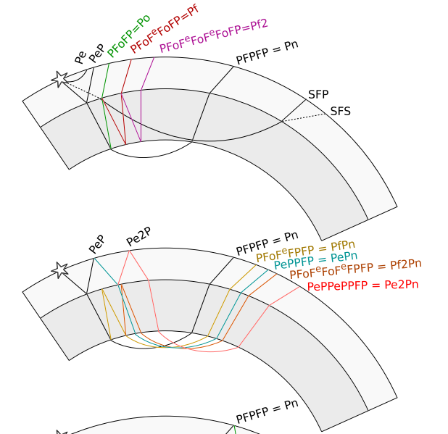
Europa’s wavefield
Body waves
Stähler et al. (2018)

Slide 16
Europa’s wavefield
Surface waves
Rayleigh (R):
Short period, radially and vertically polarized, little dispersion
Love (G):
Short period, transversely polarized, strongly dispersive
Longitudinal (LL):
Long period, radially polarized, non-dispersive
Toroidal (LQ):
Long period, transversely polarized, non-dispersive
Crary:
Narrow band, radially polarized
Flexural:
Long period, vertically polarized, strongly dispersive
Stähler et al. (2018)

Slide 17
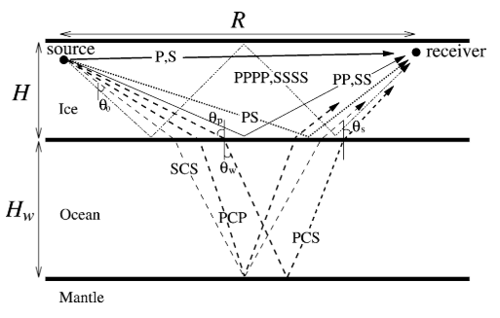
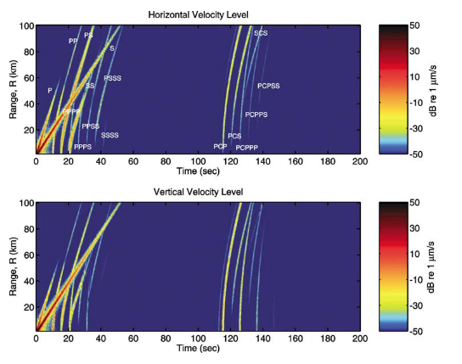
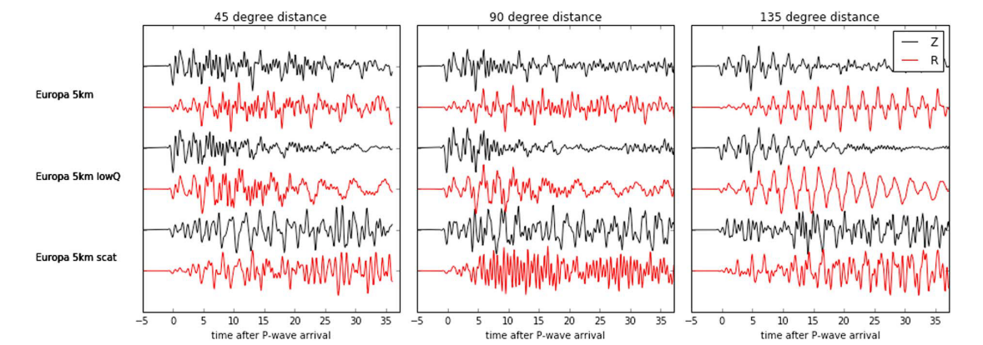
Determining ice shell thickness: Body waves
Timing between multiple reflections = ice thickness / velocity
Stähler et al. (2018)
Lee et al. (2003)

Slide 18
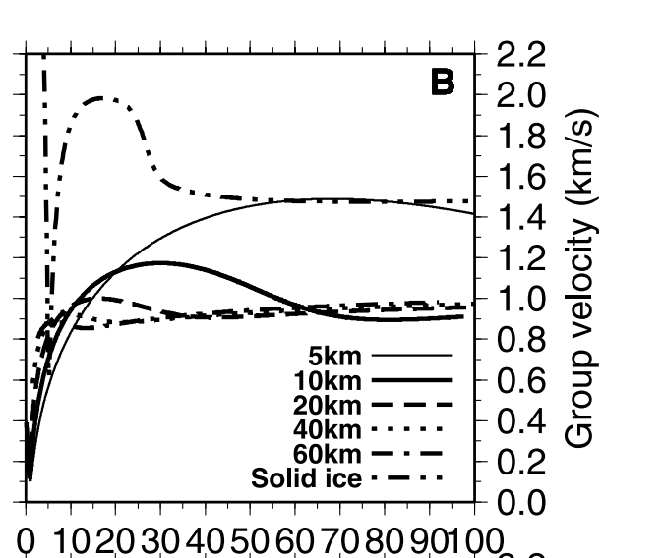
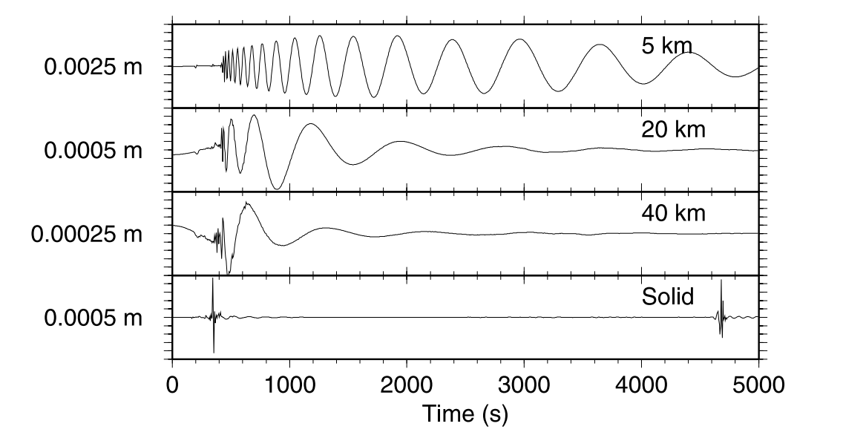
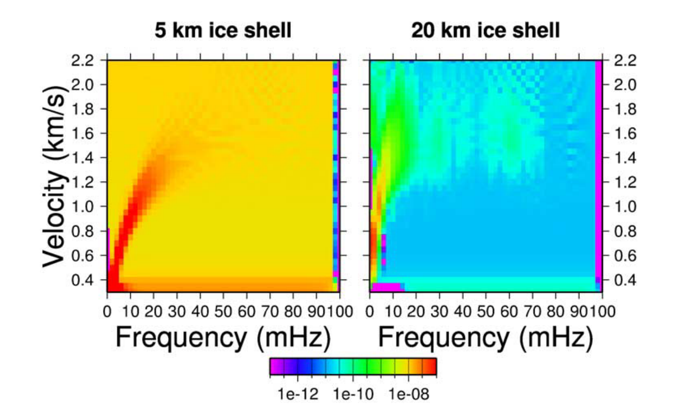
Determining ice shell thickness: Surface waves
Flexural waves
Panning et al. (2006)

Slide 19
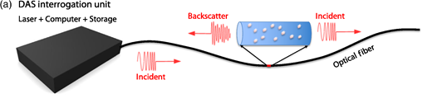
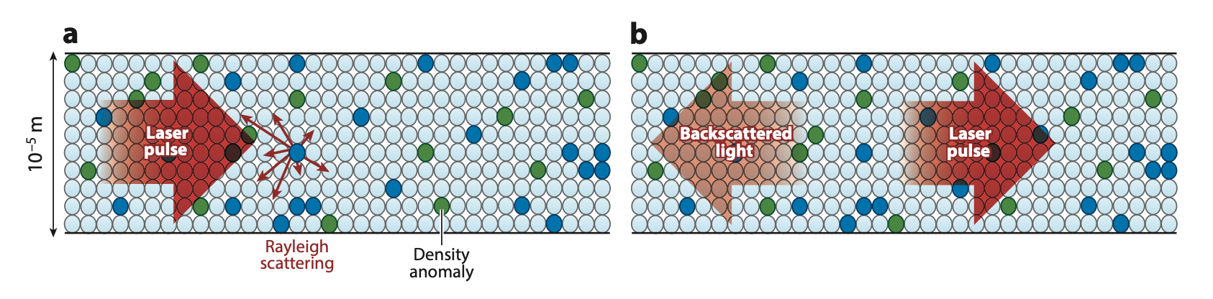
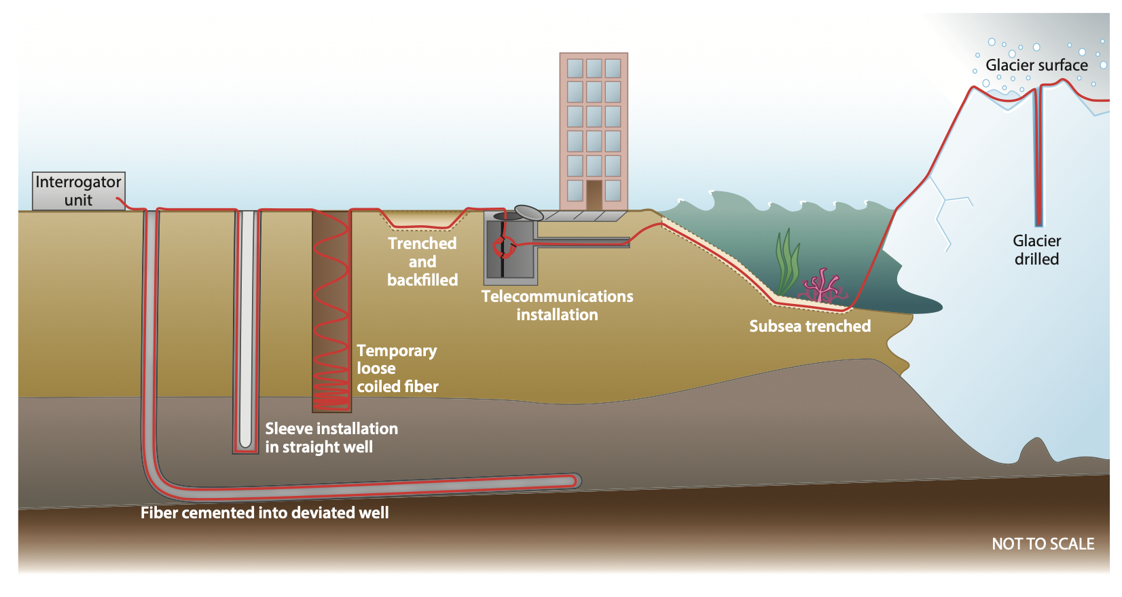
Distributed Acoustic Sensing (DAS)
DAS utilizes fiberoptic cables (commonly used for telecommunications) as a new type of seismic instrument (really a strain meter).
As a laser pulse travels through the cable, imperfections in the cable cause light to be back-scattered to the interrogator. Small strains in the cable (e.g., due to seismic waves passing through) cause phase shifts in the back-scattered energy.
Position changes of anomalies are tiny! (10’s of nanometers). Resulting time shifts can be as small as fractions of a femtosecond.
Effectively, this technique is used to turn a linear cable into a nearly continuous line of seismic sensors.
Number of channels determined by total length of fiber, and the ‘gauge length’ (~ 1 - 10 m)
Zhan, 2020
Rayleigh scattering causes signal strength to diminish by 0.15 – 0.2 dB / km
Lindsey & Martin, 2021

Slide 20
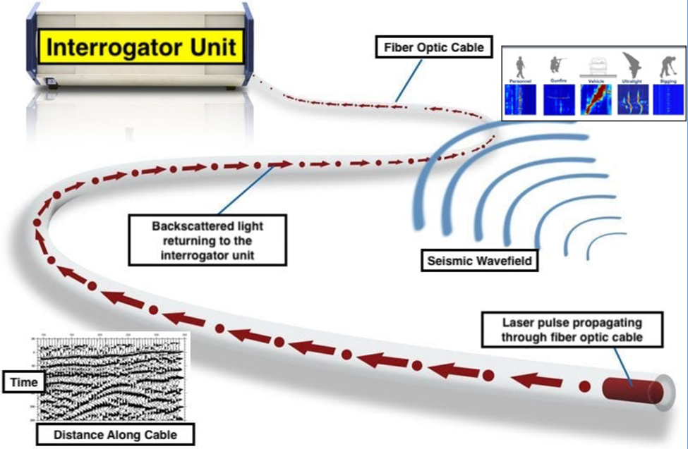

Slide 21
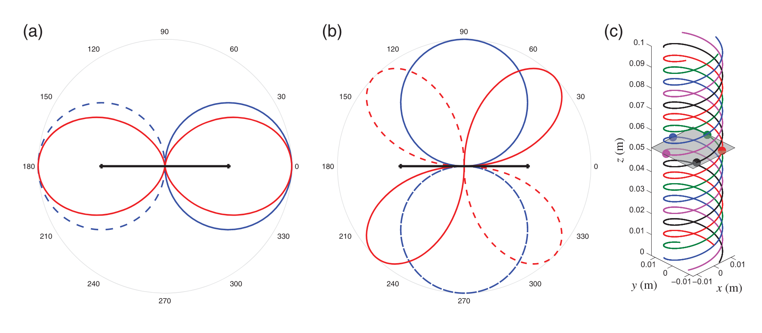
Azimuthal dependence on P and S wave detection
DAS is most sensitive to P-waves propagating along the axis of the cable, and S-waves propagating orthogonal to the cable.
Helically wound cable could increase ability to record waves from all azimuths.
Zhan, 2020

Slide 22
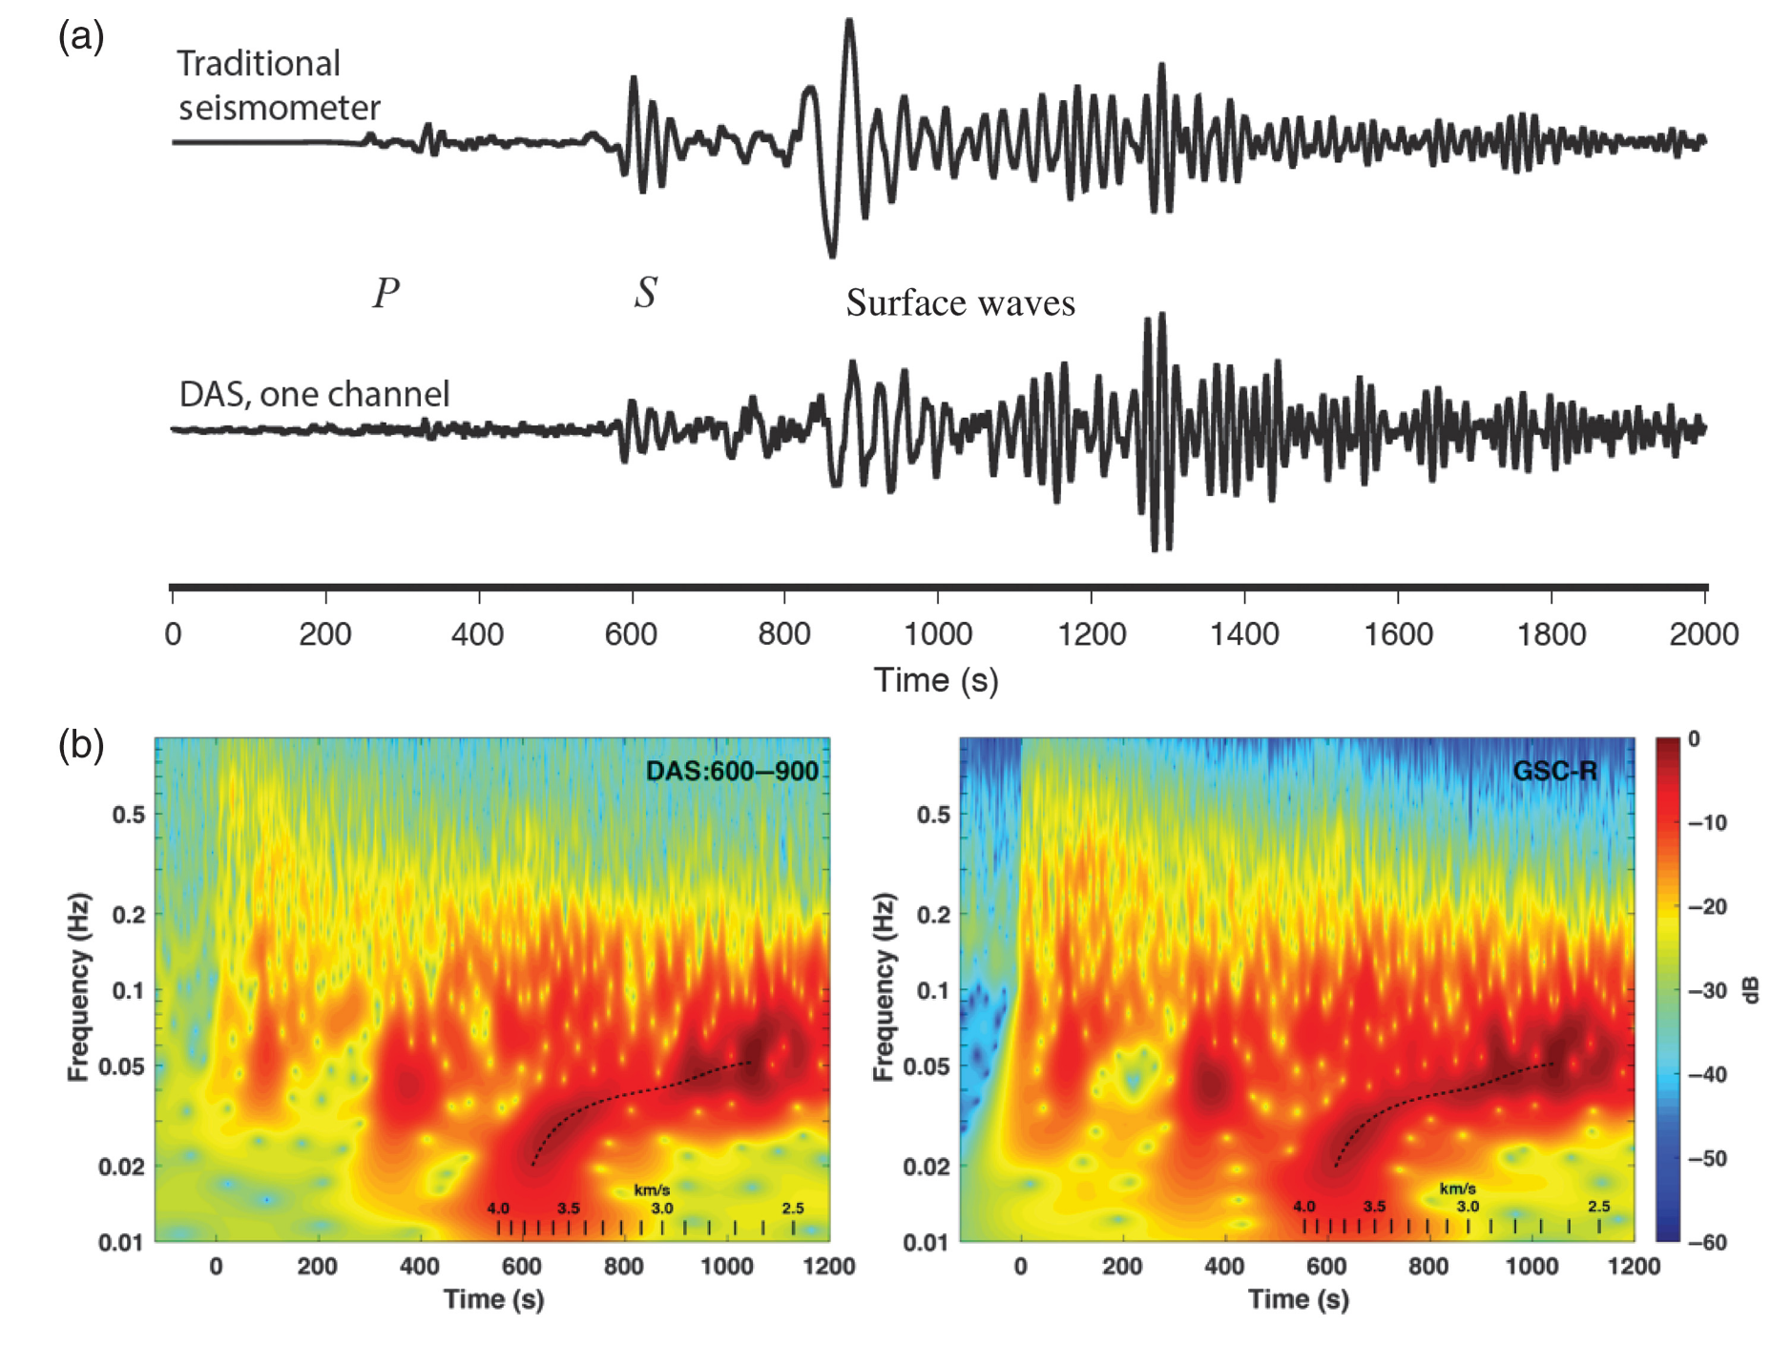
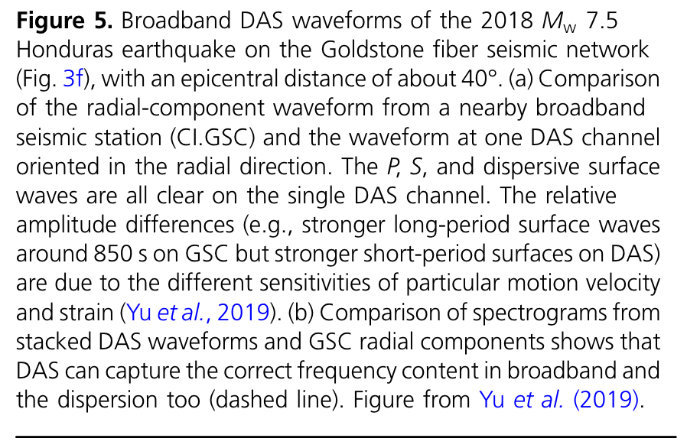

Slide 23
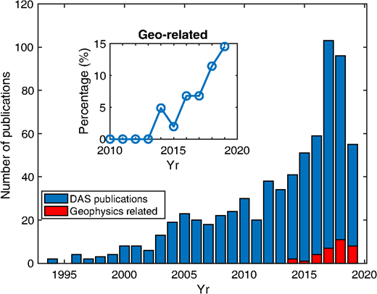
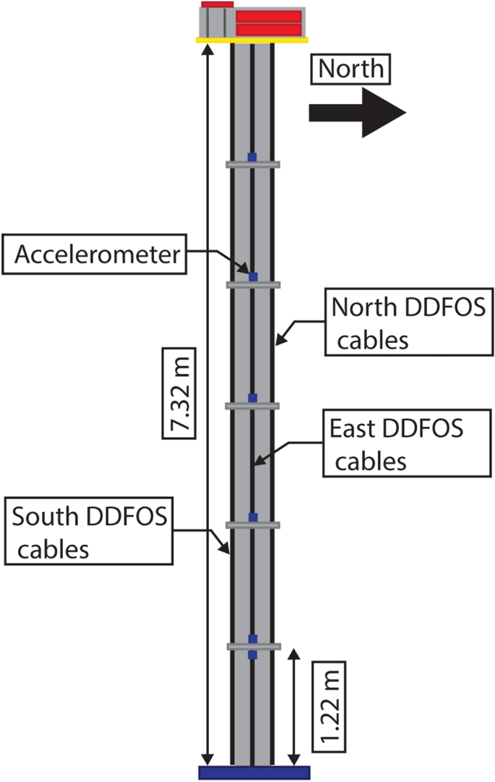
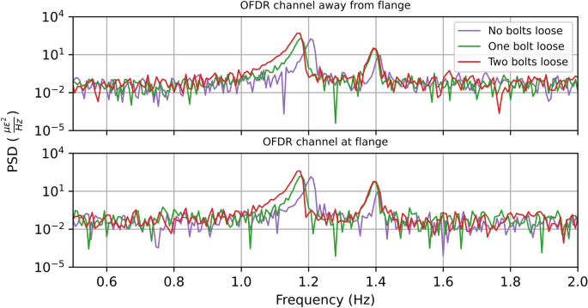
Applications of DAS
Earthquake monitoring
Imaging faults and other subsurface structures
Hazard analysis
Engineering applications (e.g., structural health monitoring)
Planetary applications (!)
Zhan, 2020
Hubbard et al., 2021

Slide 24
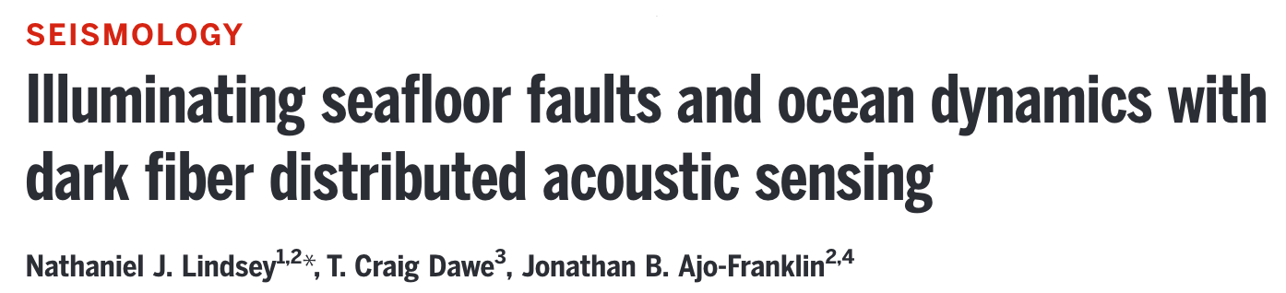
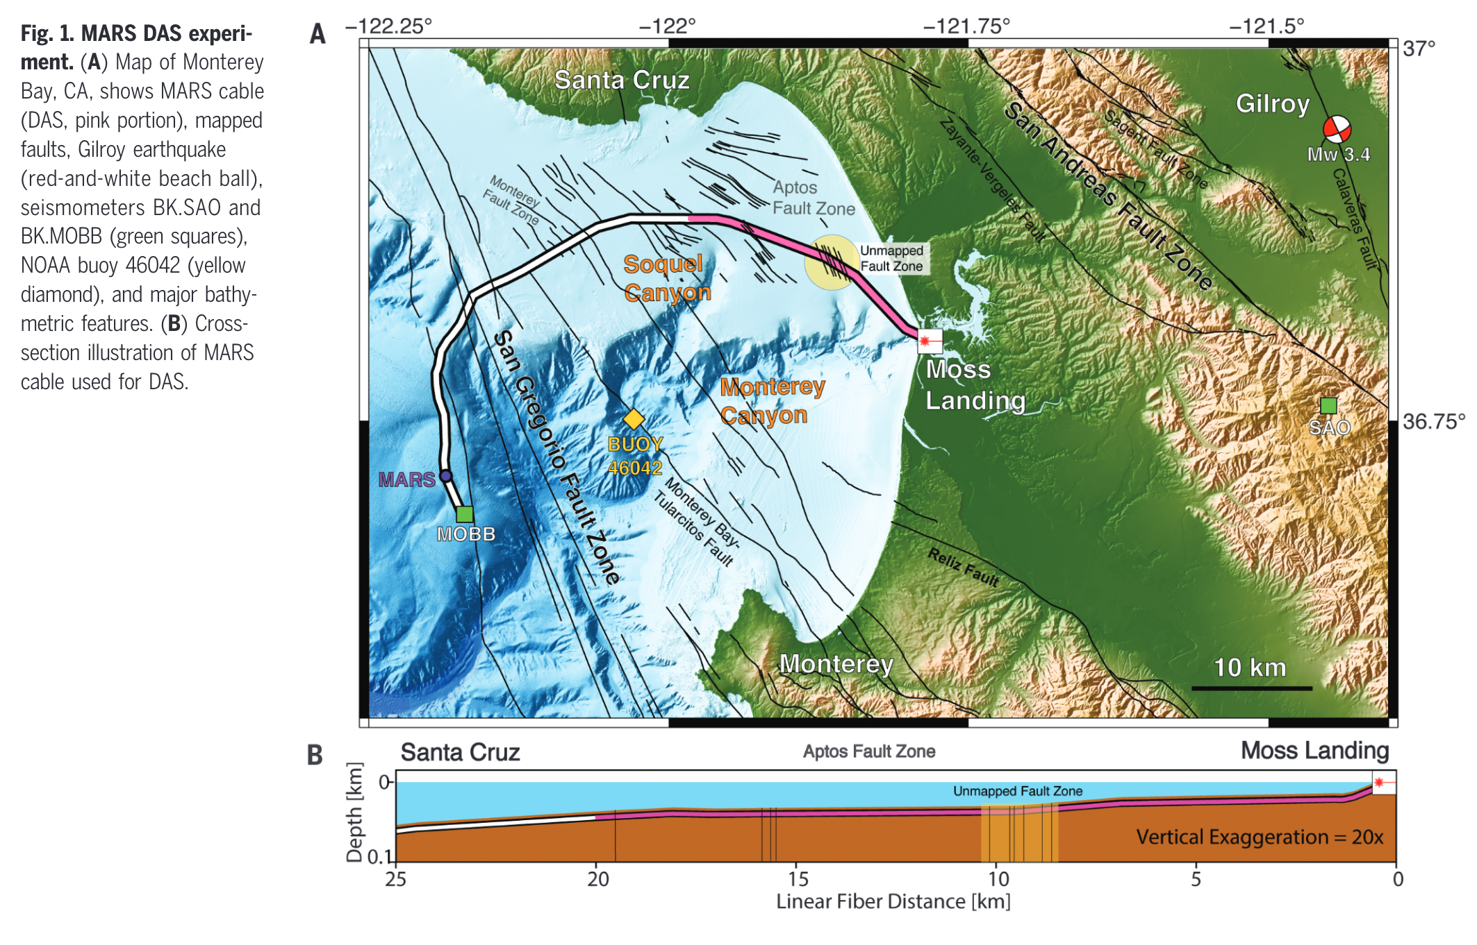
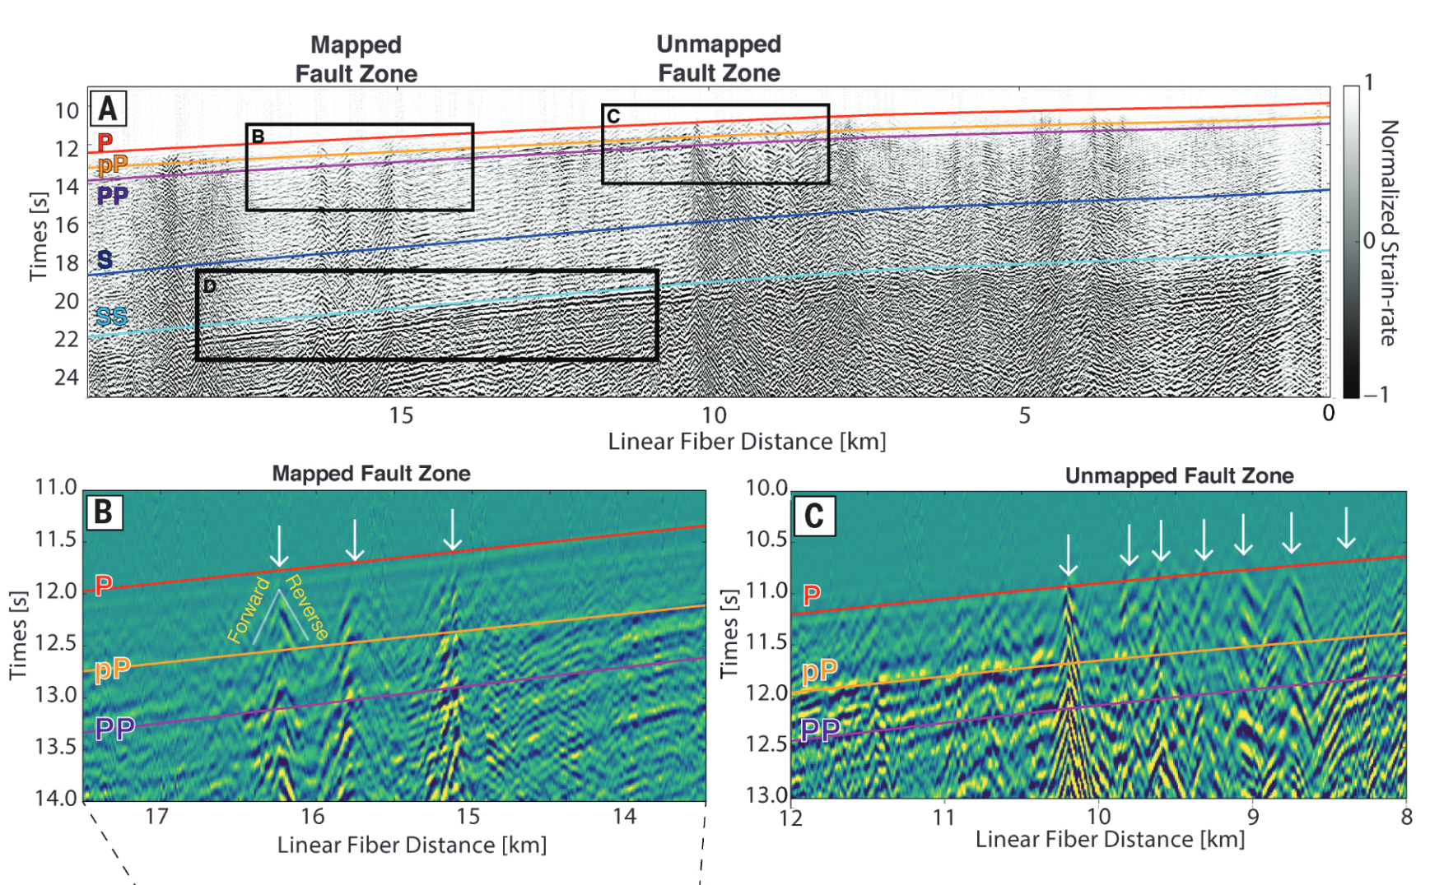
Lindsey et al., (2019) used DAS to create a 20-km linear seismic array with 10,000 channels.
Earthquake recordings by the array illuminated unknown subsea faults in Monterey Bay.
Undersea cables have great potential to be utilized for DAS, increasing global seismic coverage!

Slide 25
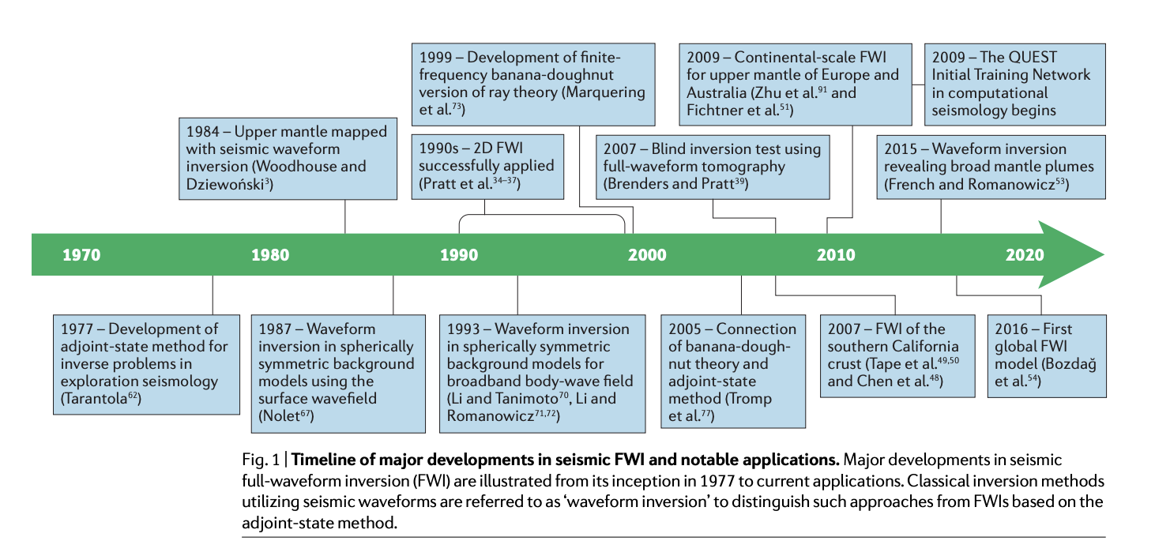
Full waveform tomography
Full waveform tomography uses computer simulations of seismic waves and minimizes the difference between observed and modeled waveforms, rather than fitting travel times of seismic phases (e.g., using ray theory).
Only relatively recently has computational power been sufficient to perform FWI for geological applications at high frequency

Slide 26
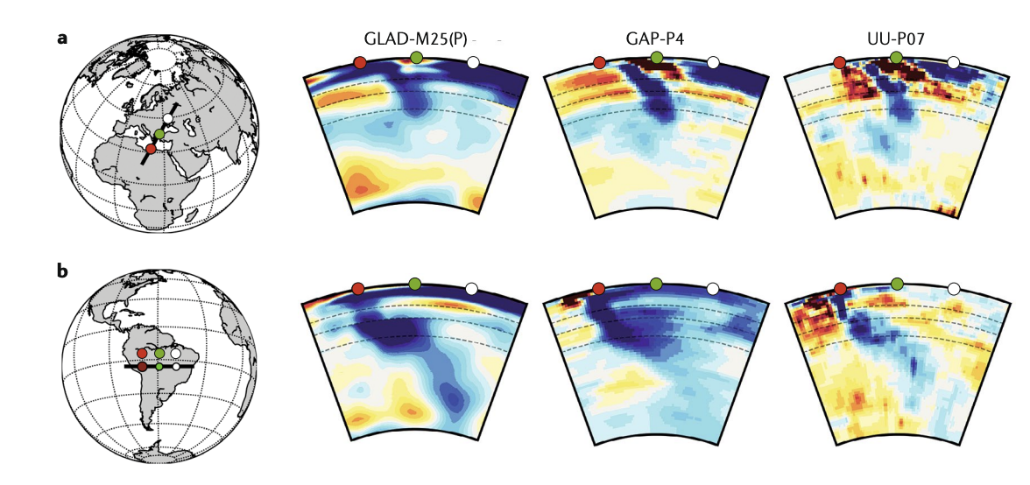
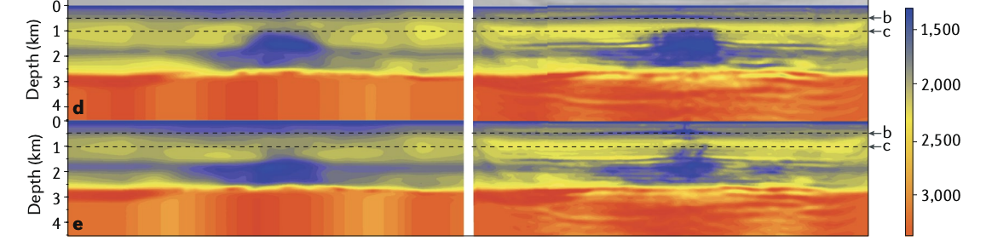
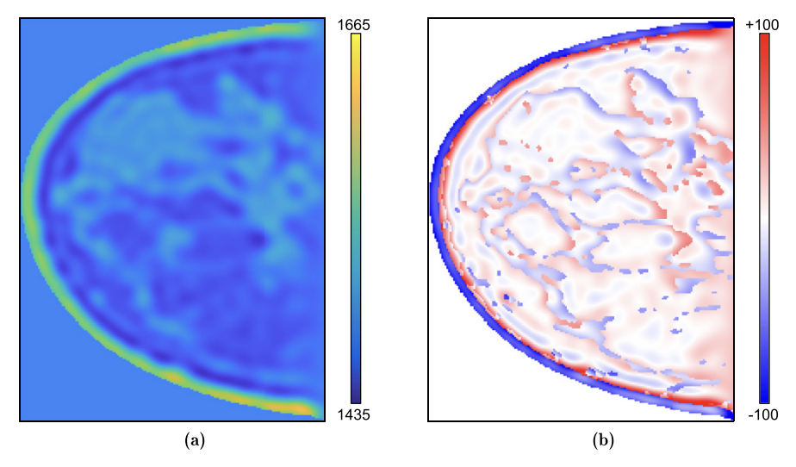
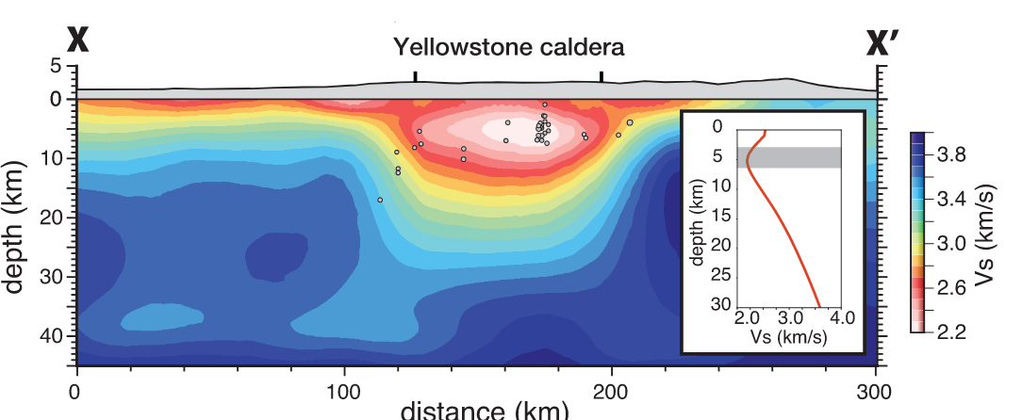
Examples of FWI studies
Global scale tomography (GLAD M-25; Lei et al., 2020)
Oil field imaging (Fig from Tromp et al., 2020)
Medical imaging (Lucka et al., 2022)
Volcano scale imaging (e.g., Maguire et al., 2022)

